Slide 1
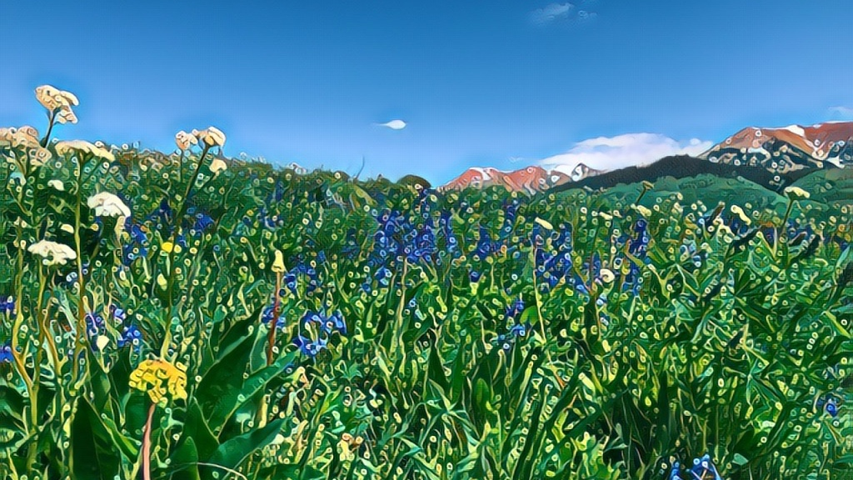
Plants in the Climate System
Nick Smith
Department of Biological Sciences
Texas Tech University
nick.smith@ttu.edu

Slide 2
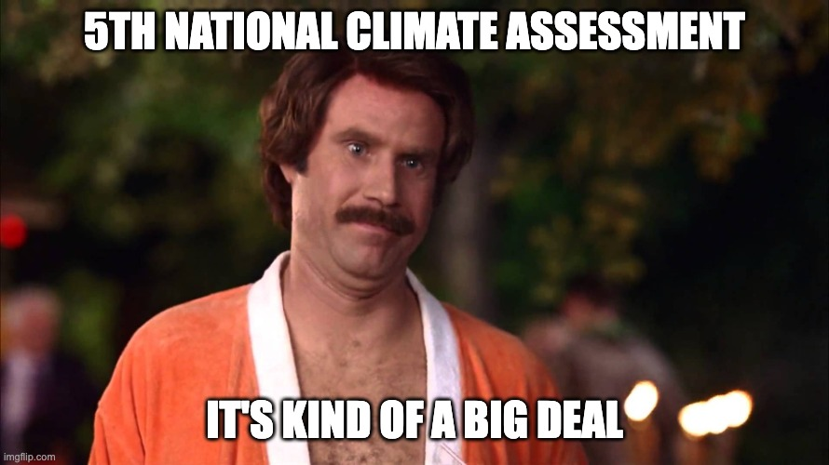
Something important happened yesterday…
nca2023.globalchange.gov
nick.smith@ttu.edu

Slide 3
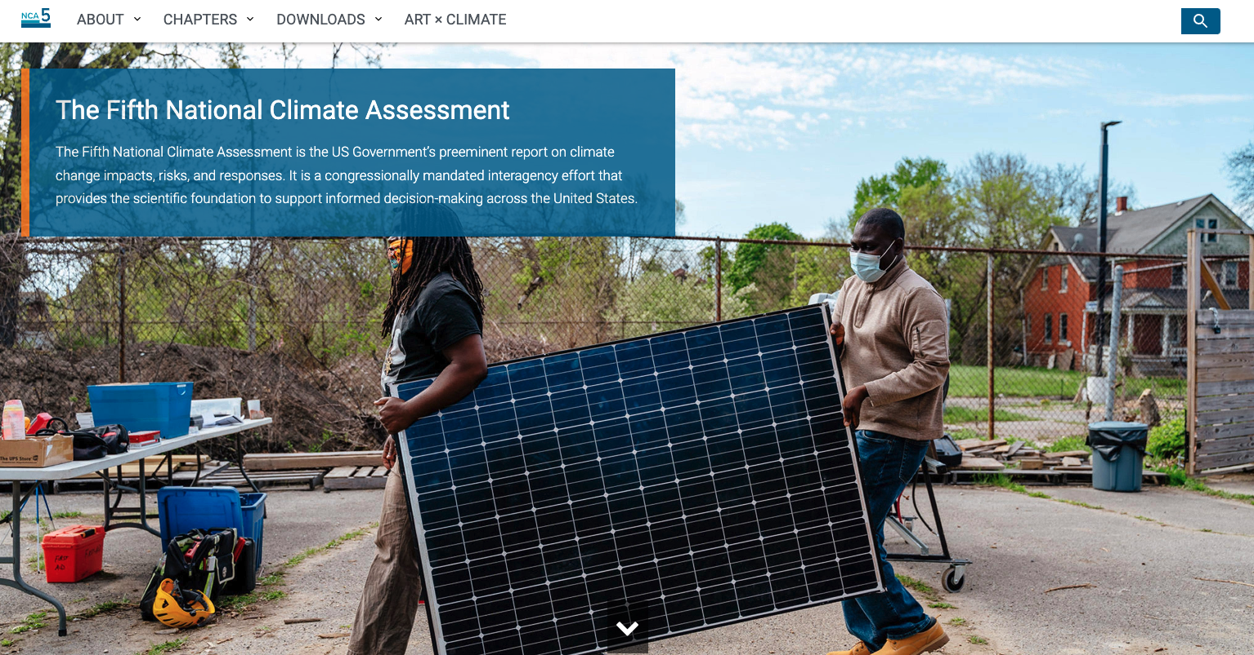

On Nov. 14, 2023 the 5th National Climate Assessment (NCA5) was released!
nca2023.globalchange.gov
nick.smith@ttu.edu

Slide 4
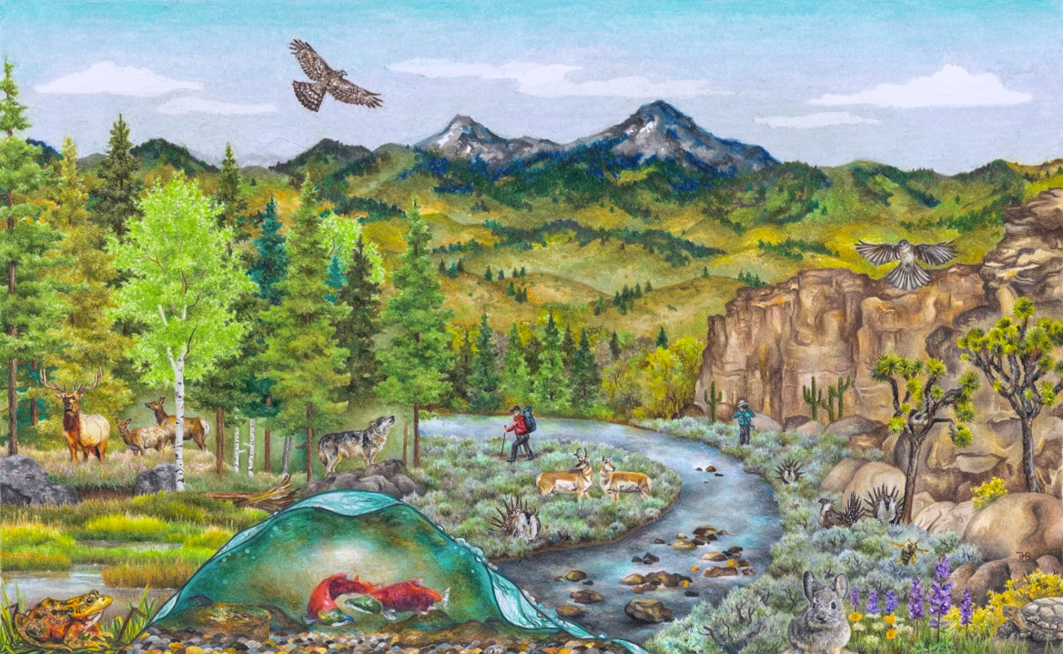
What is NCA5?
nca2023.globalchange.gov
nick.smith@ttu.edu
US government report
Congressionally mandated and overseen by multiple agencies
Delivered to congress and the president
Climate change impacts, risks, and responses for USA
Provides scientific foundation for decision making
Policy relevant, but not policy prescriptive

Slide 5
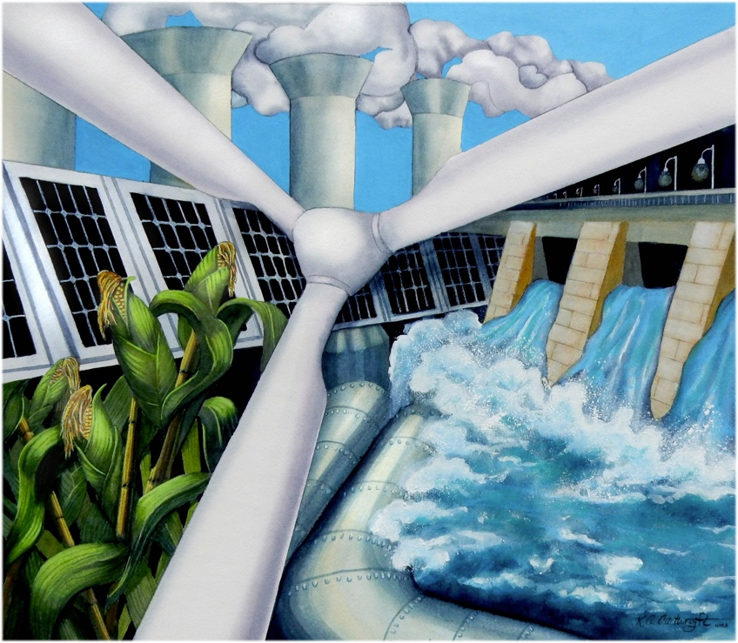
What is NCA5? Mandate
nca2023.globalchange.gov
nick.smith@ttu.edu
Result of the Global Change Research Act of 1990
Every 4 years a report that “analyzes the effects of global change on the natural environment, agriculture, energy production and use, land and water resources, transportation, human health and welfare, human social systems, and biological diversity; and analyzes current trends in global change, both human-induced and natural, and projects major trends for the subsequent 25 to 100 years”

Slide 6
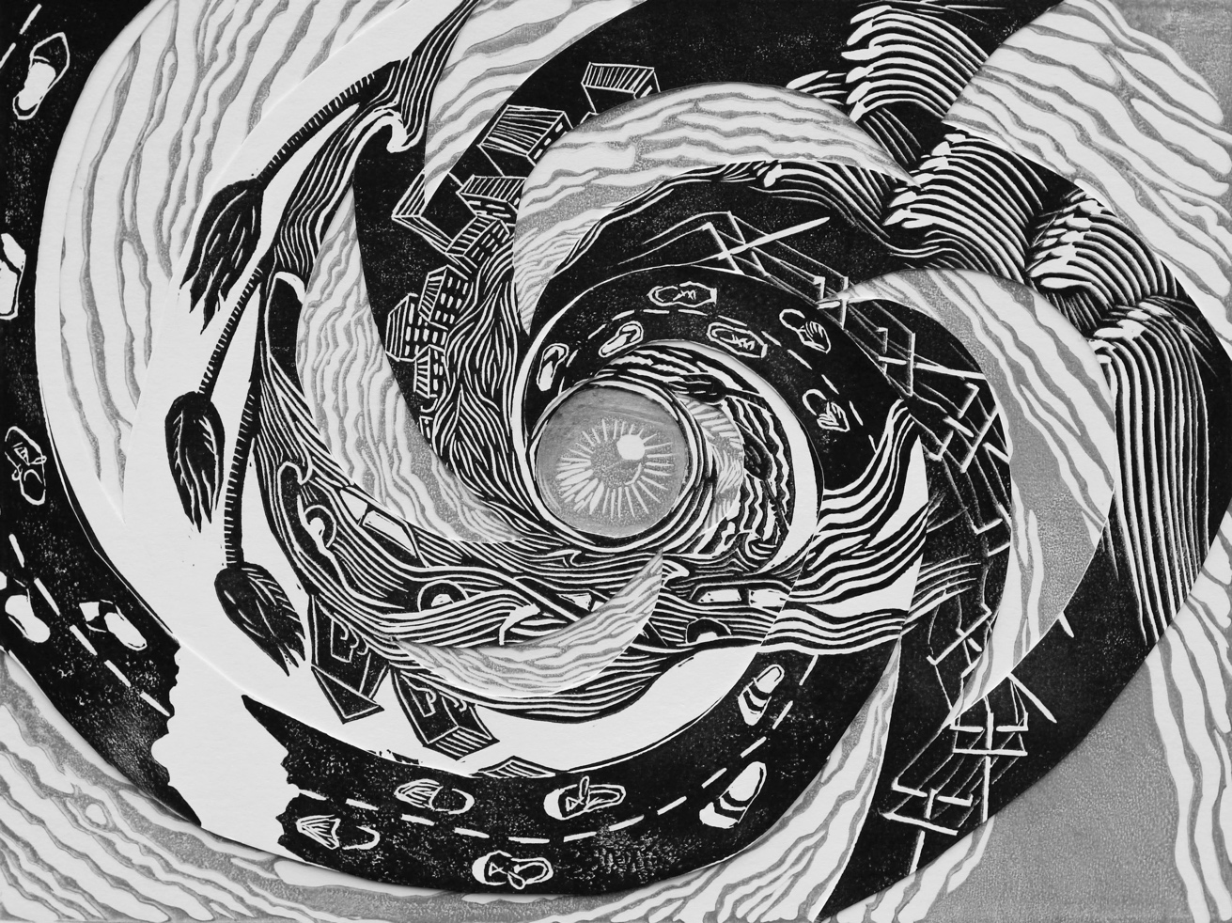
What is NCA5? Review process
nca2023.globalchange.gov
nick.smith@ttu.edu
Reviewed by:
Federal government experts
External experts
General public
External reviewers from NASEM
Review by each group multiple times throughout the process
All reviews responded to

Slide 7
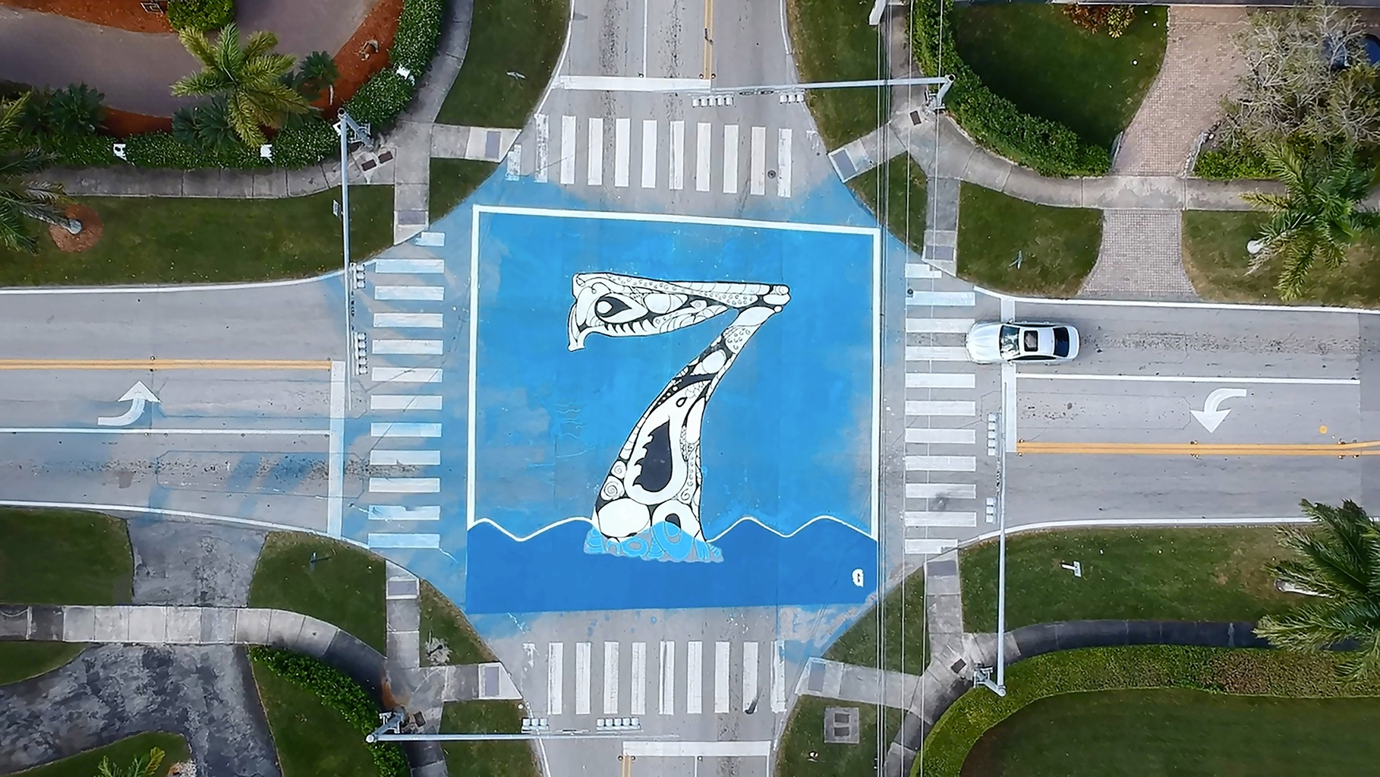
What is NCA5? Audience
nca2023.globalchange.gov
nick.smith@ttu.edu
Audience: decision makers
national, state, local, and Tribal governments, city planners, public health officials, adaptation specialists, nurses, farmers, business owners, community organizers, researchers, water utilities, ecosystem managers, educators, students, the media, and concerned individuals

Slide 8
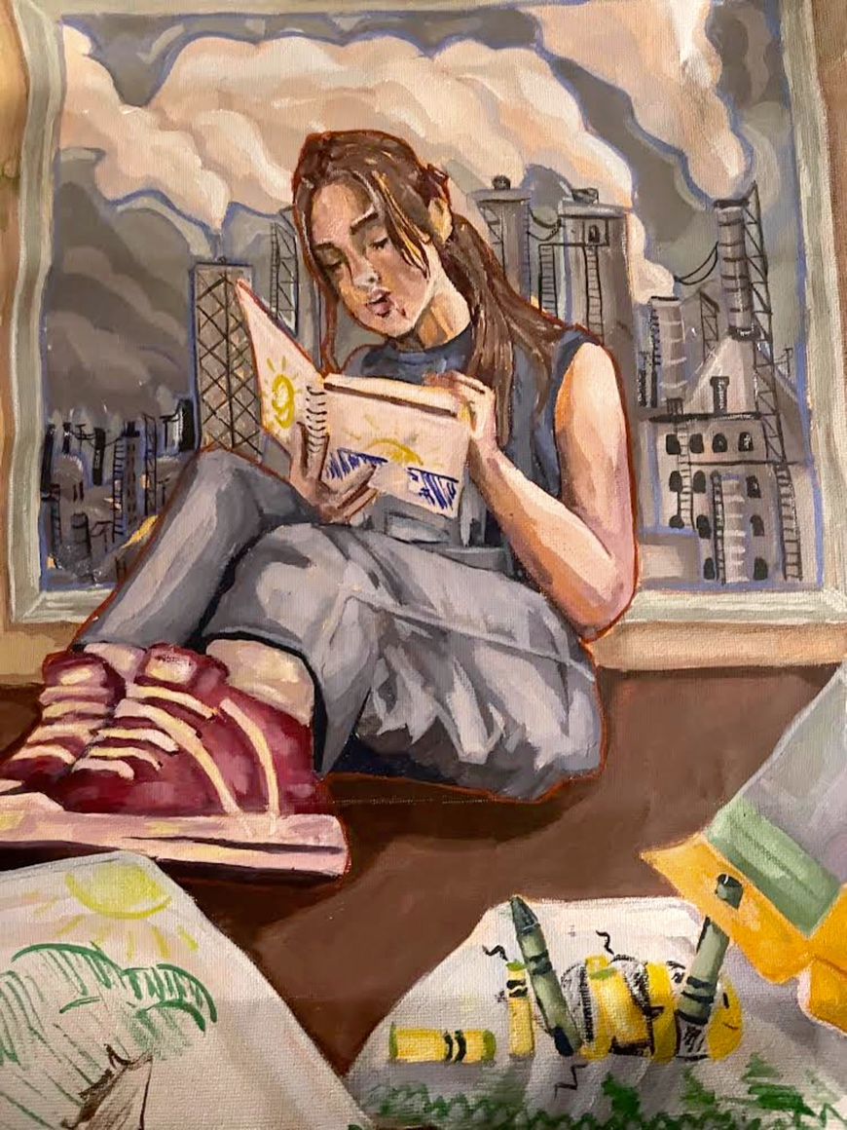
What is NCA5? Structure
nca2023.globalchange.gov
nick.smith@ttu.edu
Each chapter has list of key messages
Conclusions based on authors’ expert judgment and synthesis of the assessed information sources
Often present findings in the context of risks to natural and/or human systems

Slide 9
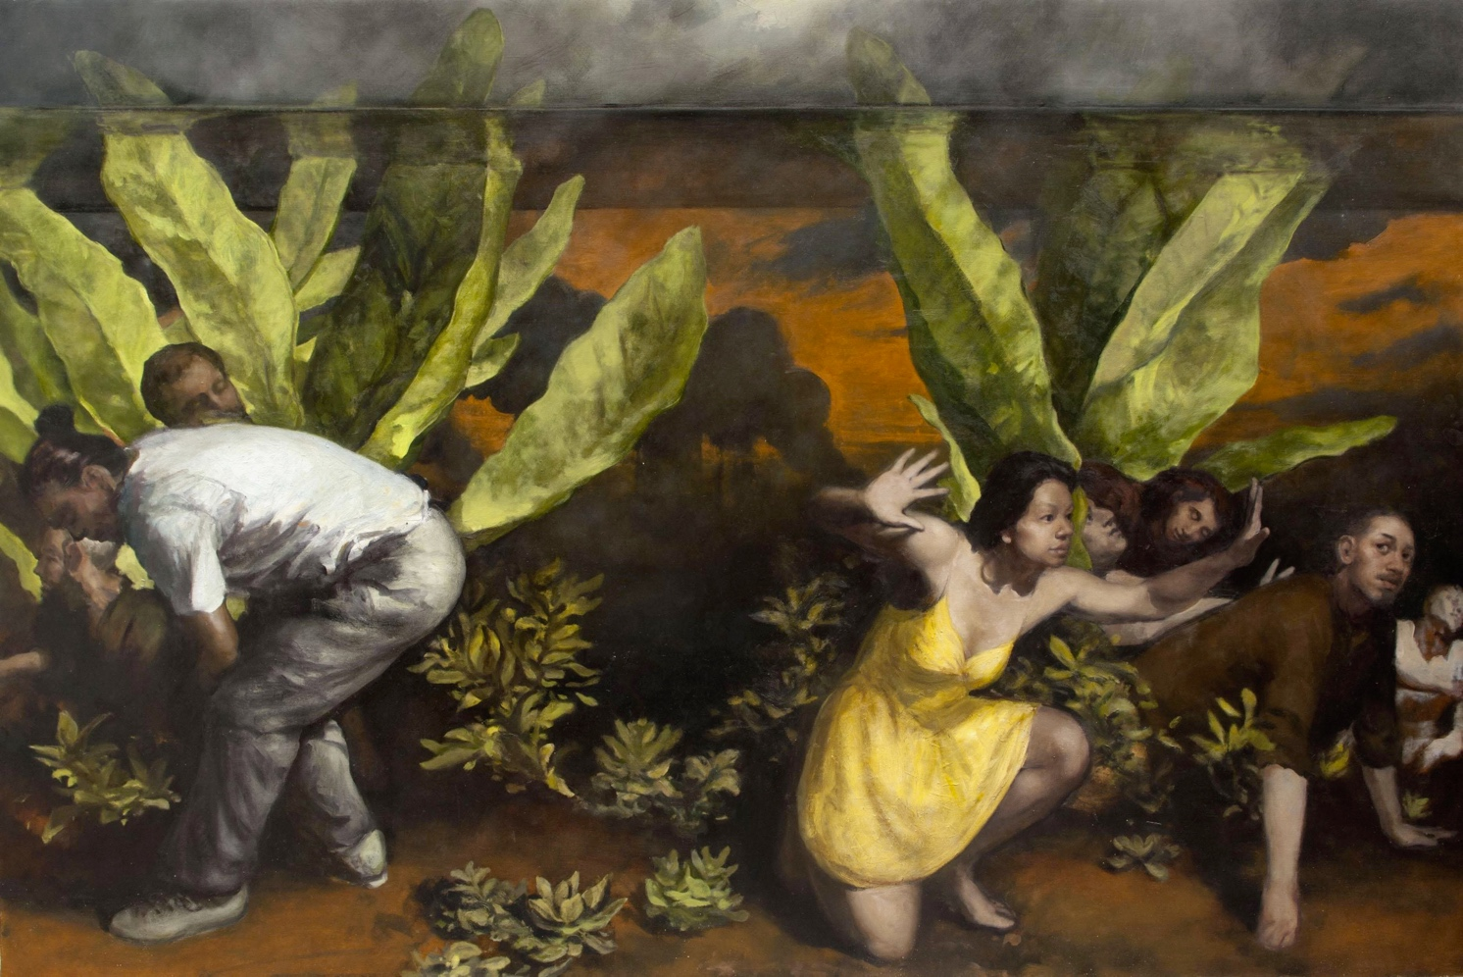
What is NCA5? Confidence and Likelihood
nca2023.globalchange.gov
nick.smith@ttu.edu
Calibrated terms in key messages
Confidence: based on the type, amount, quality, strength, and consistency of evidence; the skill, range, and consistency of methods to detect, evaluate, attribute, and interpret climate trends; and the degree of agreement across scientific information sources
Likelihood: based on measures of certainty expressed probabilistically

Slide 10
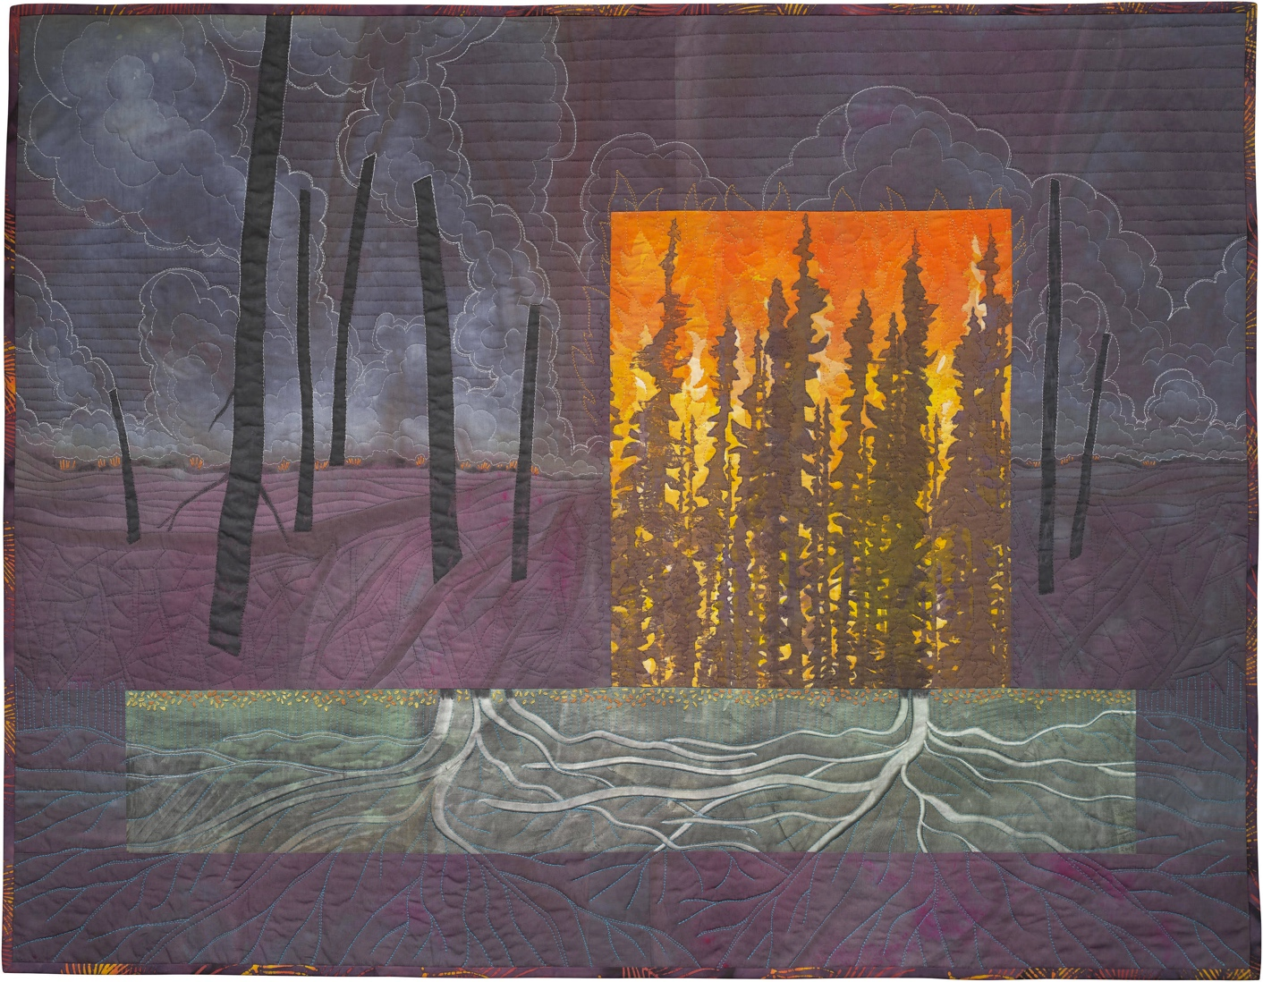
What is NCA5? Content
nca2023.globalchange.gov
nick.smith@ttu.edu
Four categories of chapters
Overview chapter (Ch. 1)
Physical science chapters (Ch. 2-3)
National topics chapters (Ch. 4-20)
Regional chapters (Ch. 21-30)
Response chapters (Ch. 31-32)

Slide 11
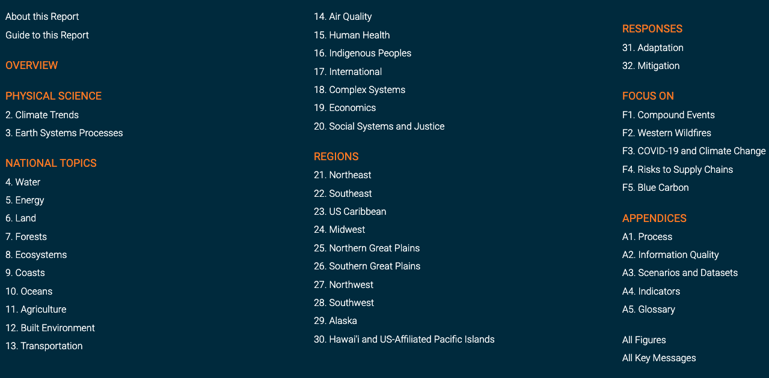
nca2023.globalchange.gov
nick.smith@ttu.edu

Slide 12
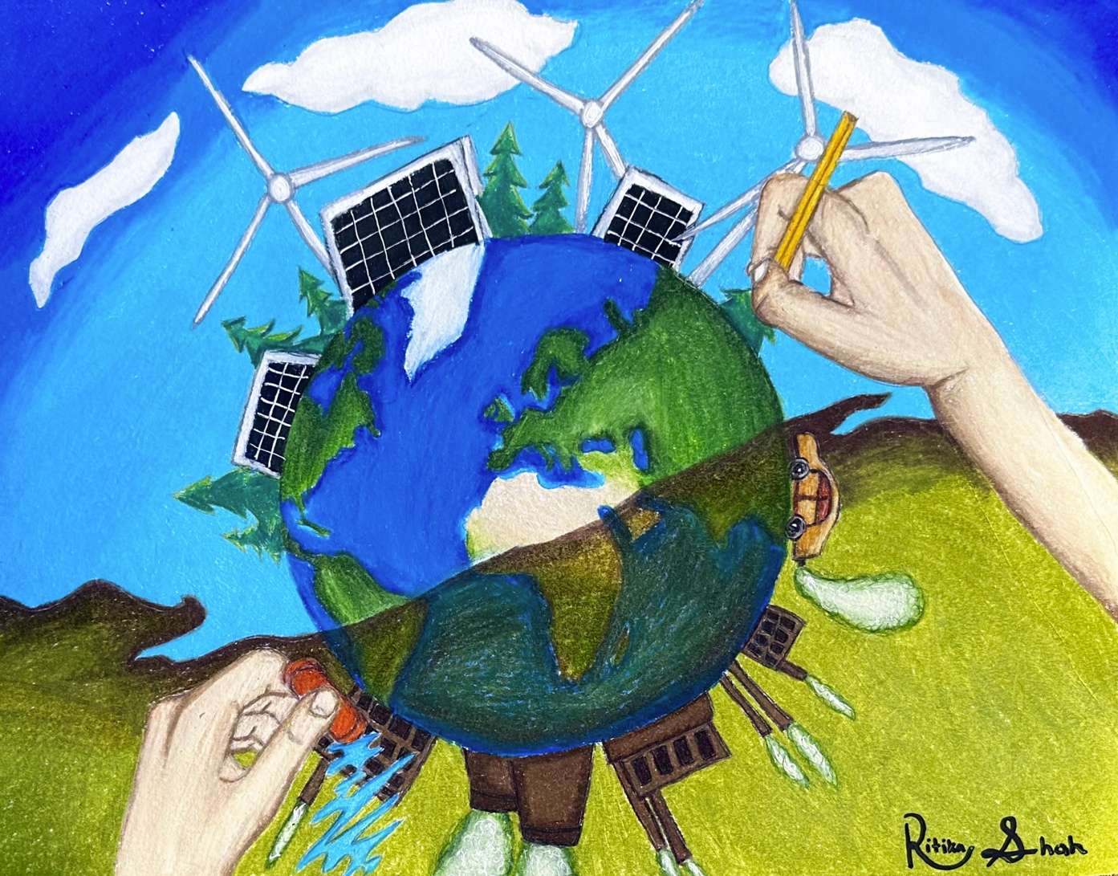
What is NCA5? Content
nca2023.globalchange.gov
nick.smith@ttu.edu
Four categories of chapters
Overview chapter (Ch. 1)
Physical science chapters (Ch. 2-3)
National topics chapters (Ch. 4-20)
Regional chapters (Ch. 21-30)
Response chapters (Ch. 31-32)

Slide 13
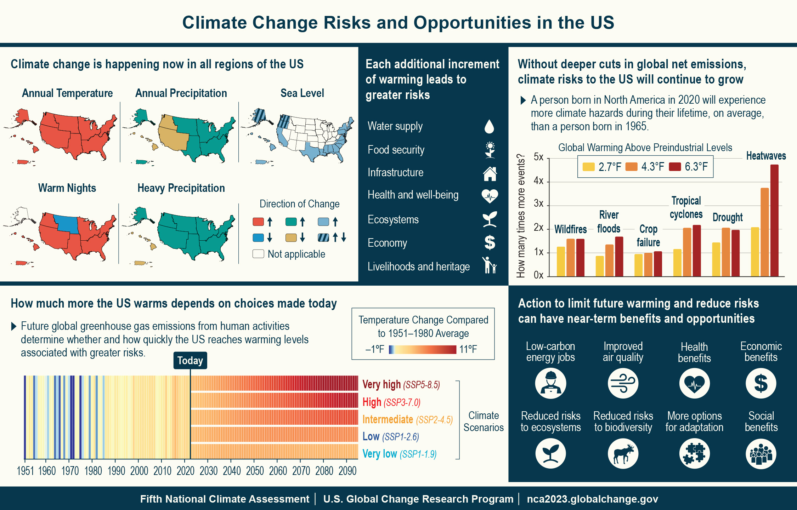
The effects of climate change are worsening, but depend on decisions we make today
nca2023.globalchange.gov
nick.smith@ttu.edu

Slide 14
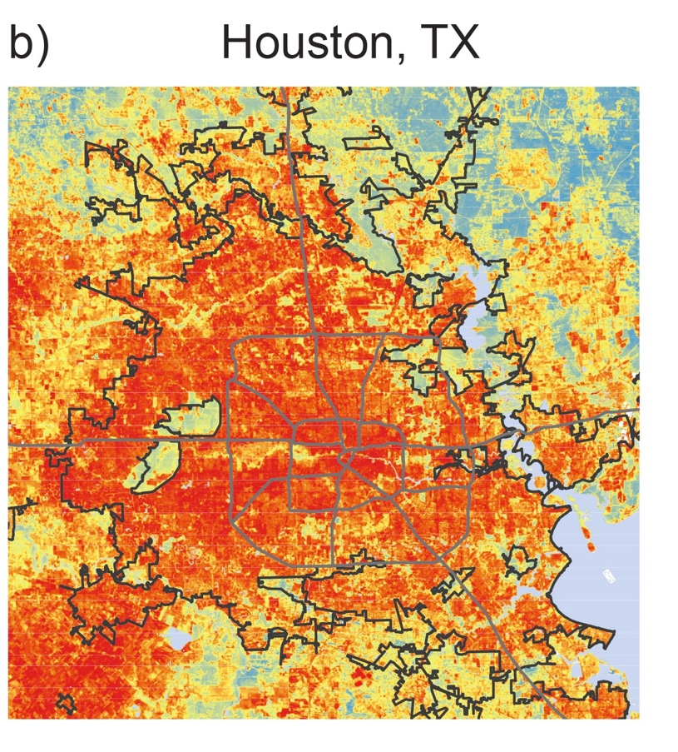
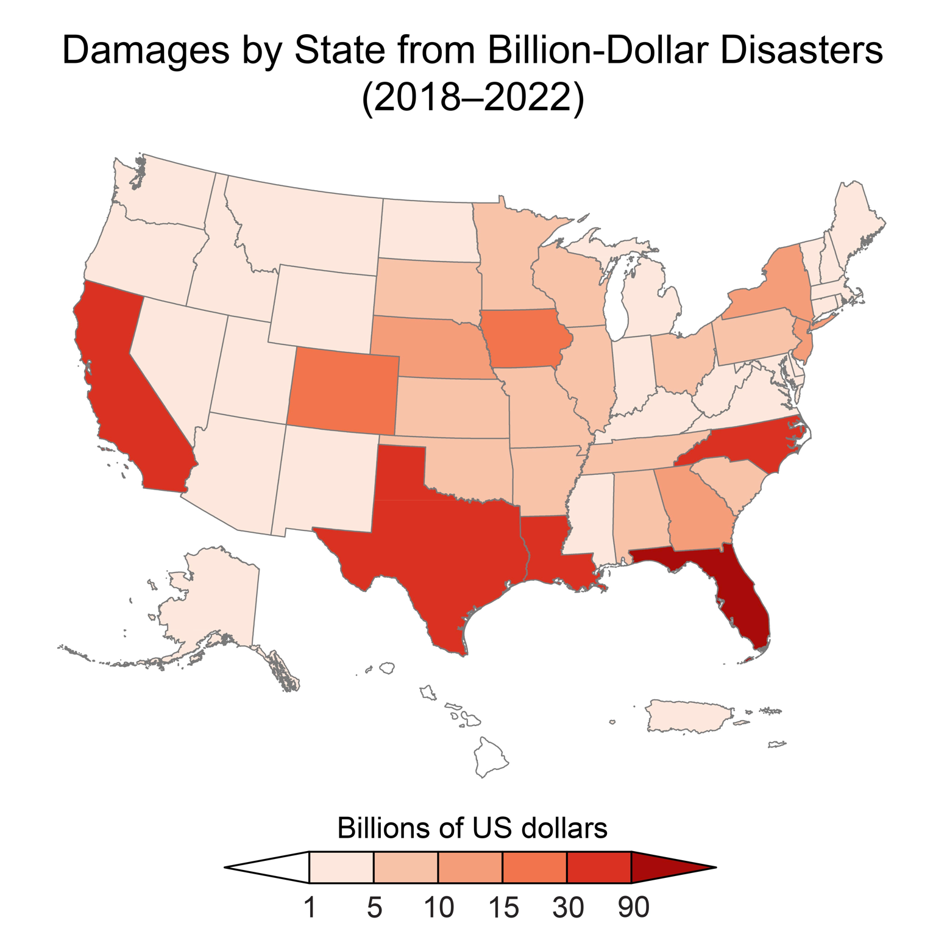
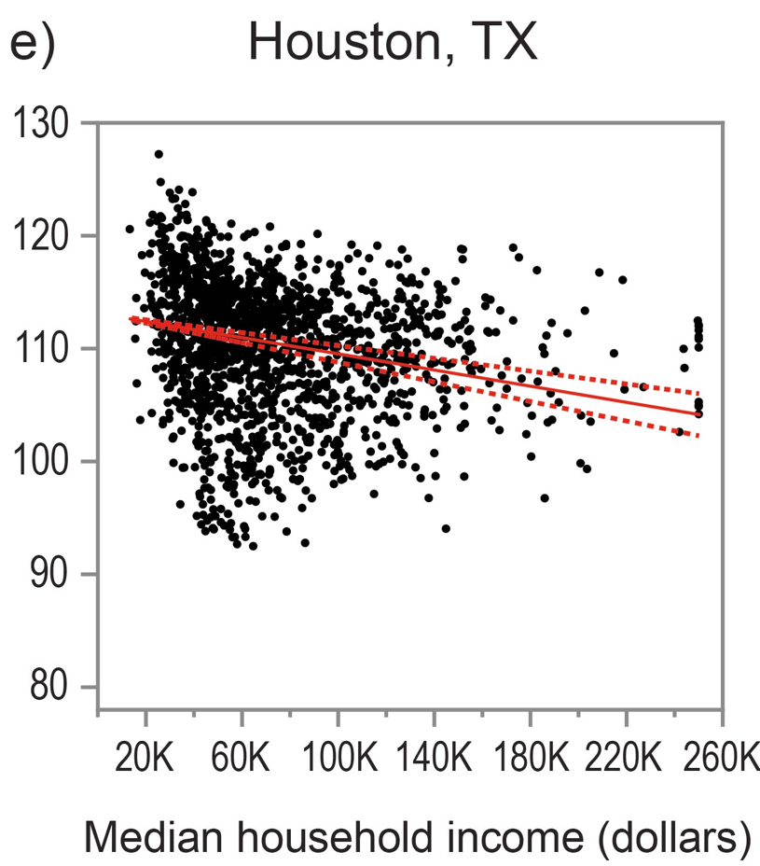
Climate change is harming people, with disproportionate effects on underserved and overburdened communities
nca2023.globalchange.gov
nick.smith@ttu.edu

Slide 15
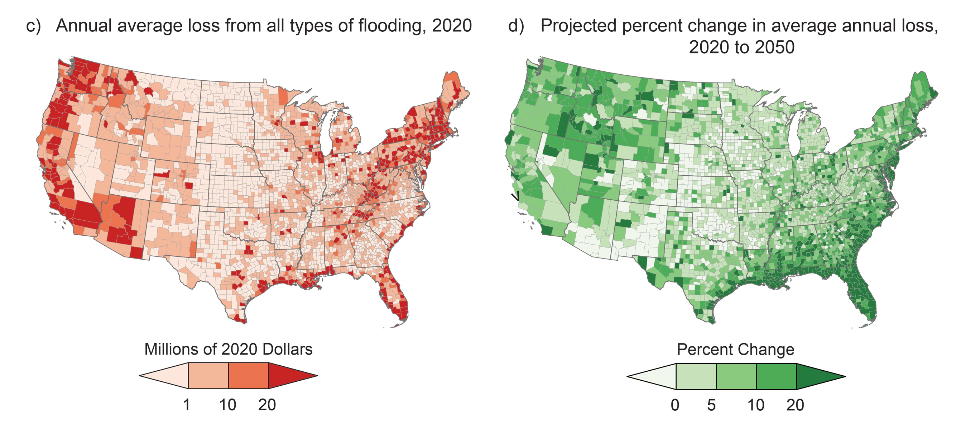
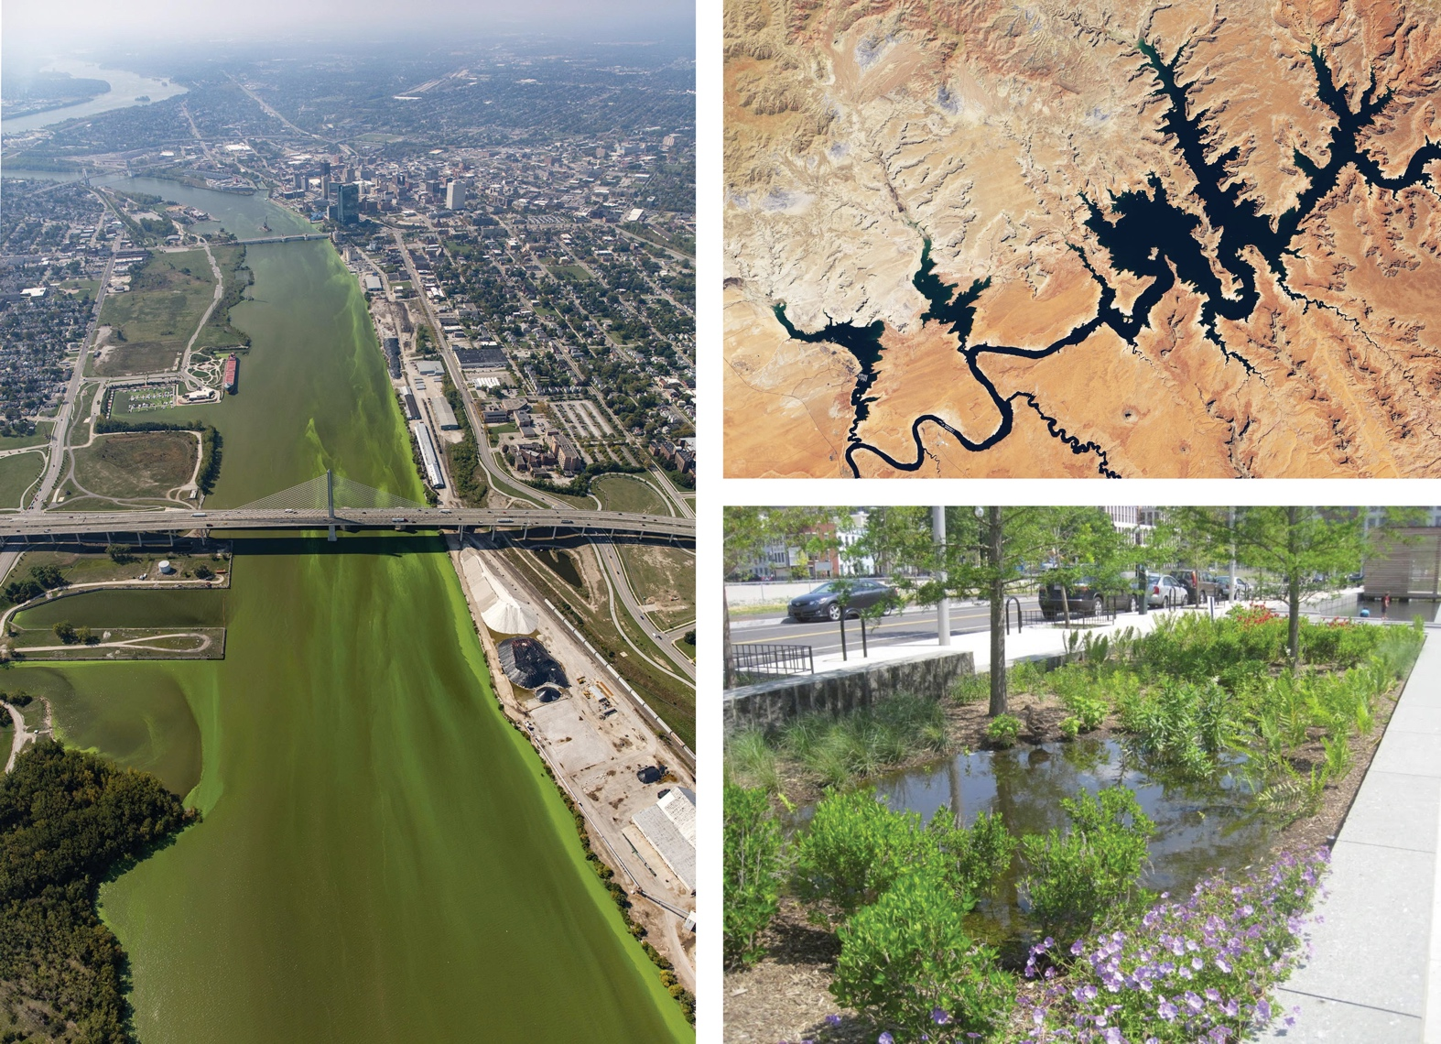
Climate change is making life harder for people
nca2023.globalchange.gov
nick.smith@ttu.edu

Slide 16
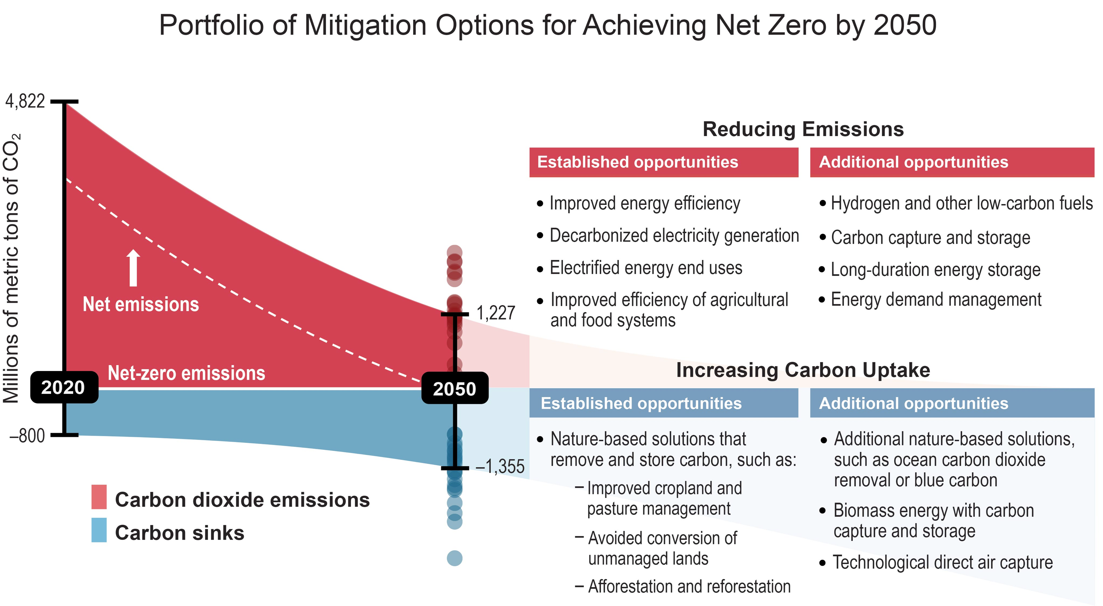
We determine our future
nca2023.globalchange.gov
nick.smith@ttu.edu

Slide 17
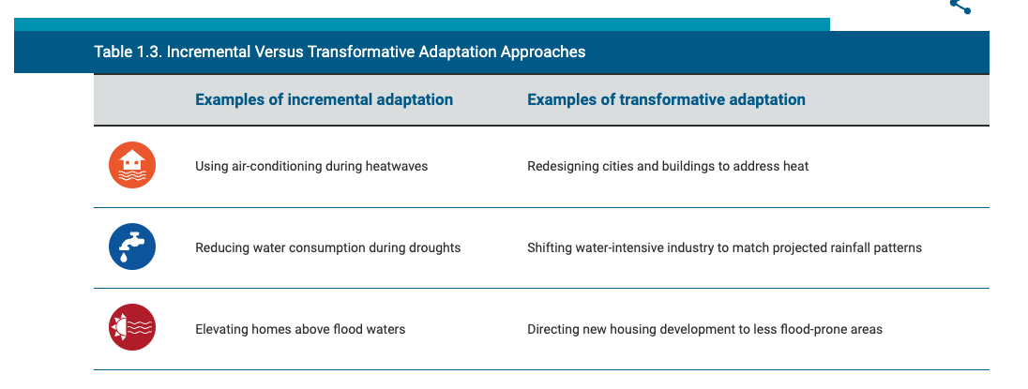
We determine our future
nca2023.globalchange.gov
nick.smith@ttu.edu

Slide 18
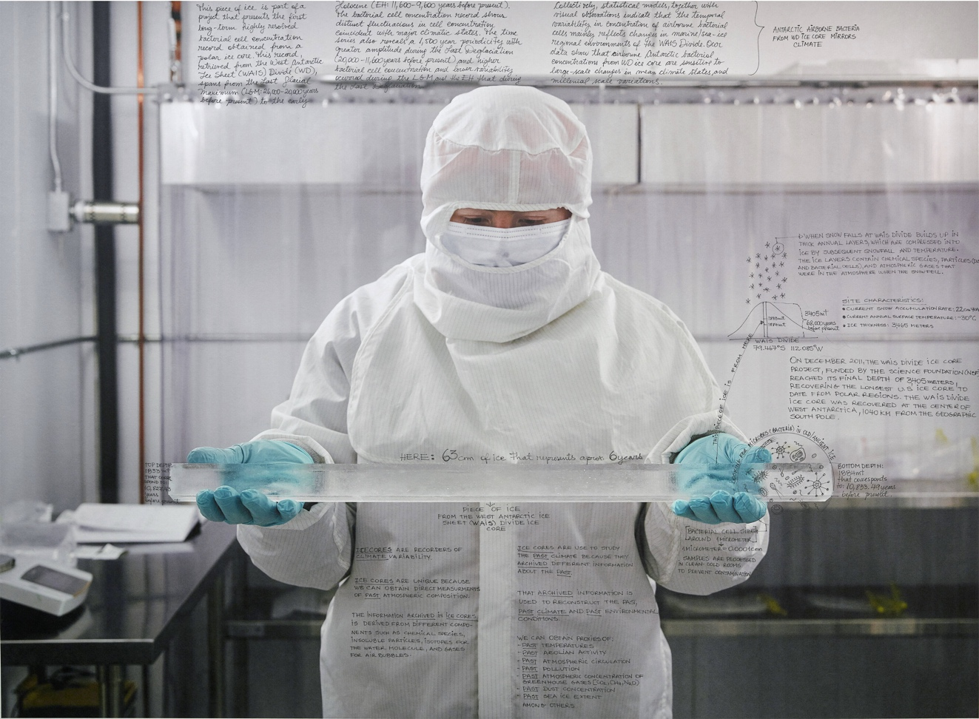
What is NCA5? Content
nca2023.globalchange.gov
nick.smith@ttu.edu
Four categories of chapters
Overview chapter (Ch. 1)
Physical science chapters (Ch. 2-3)
National topics chapters (Ch. 4-20)
Regional chapters (Ch. 21-30)
Response chapters (Ch. 31-32)

Slide 19
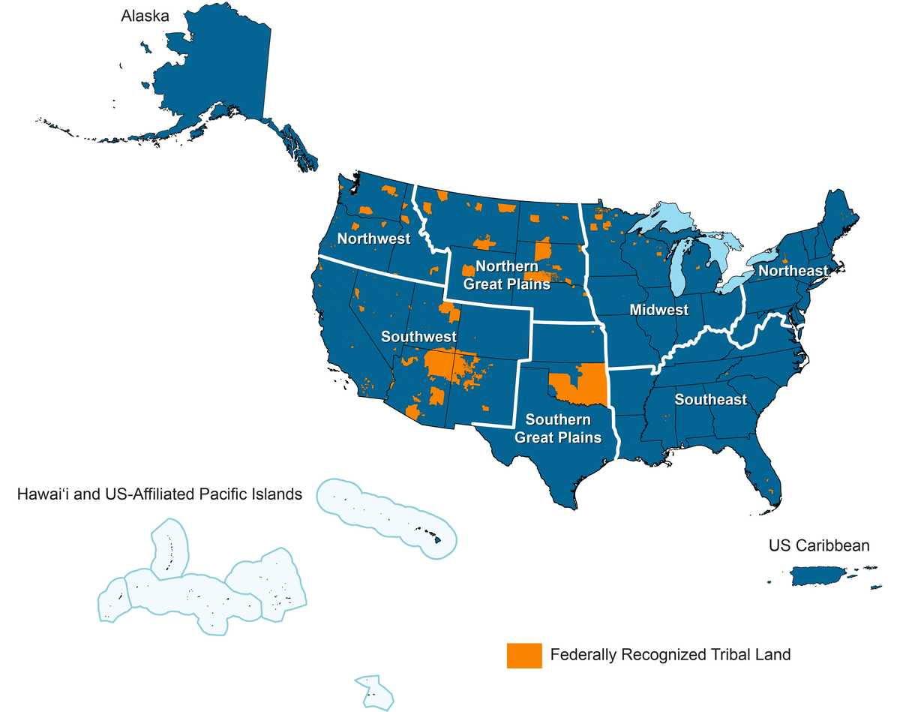
nca2023.globalchange.gov
nick.smith@ttu.edu

Slide 20
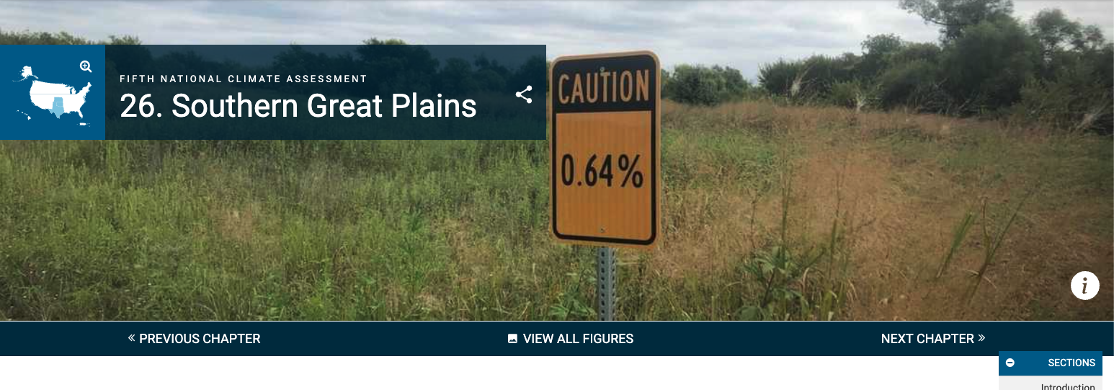
nca2023.globalchange.gov
nick.smith@ttu.edu

Slide 21
Climate change is degrading the air, lands, and waters that people in the Southern Great Plains rely on for economic, recreational, and cultural activities. These impacts compound existing burdens on those who have the fewest resources to prepare and adapt. People are adapting through nature-based solutions, reliance on Indigenous and local knowledges, and resilient infrastructure that enhances public health and the region’s economy.
nca2023.globalchange.gov
nick.smith@ttu.edu

Slide 22
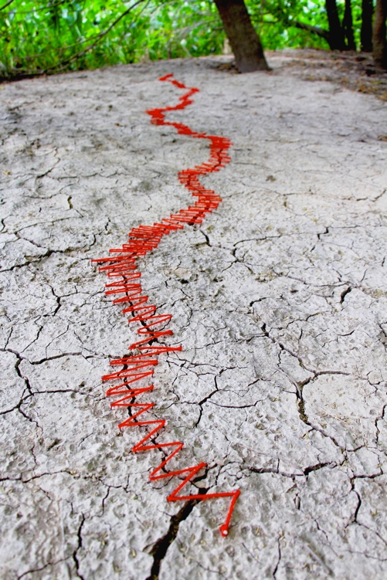
SGP KM1: How We Live: Climate Change Is Degrading Lands, Waters, Culture, and Health
nca2023.globalchange.gov
nick.smith@ttu.edu
Climate change is…putting us at risk from climate hazards that degrade our lands and waters, quality of life, health and well-being, and cultural interconnectedness (high confidence). Many climate hazards are expected to become more frequent, intense, or prolonged…(very likely, high confidence)…effective climate-resilient actions include implementing nature-based solutions; valuing Indigenous, traditional, and local knowledges; and infusing climate change solutions into community planning (medium confidence).

Slide 23
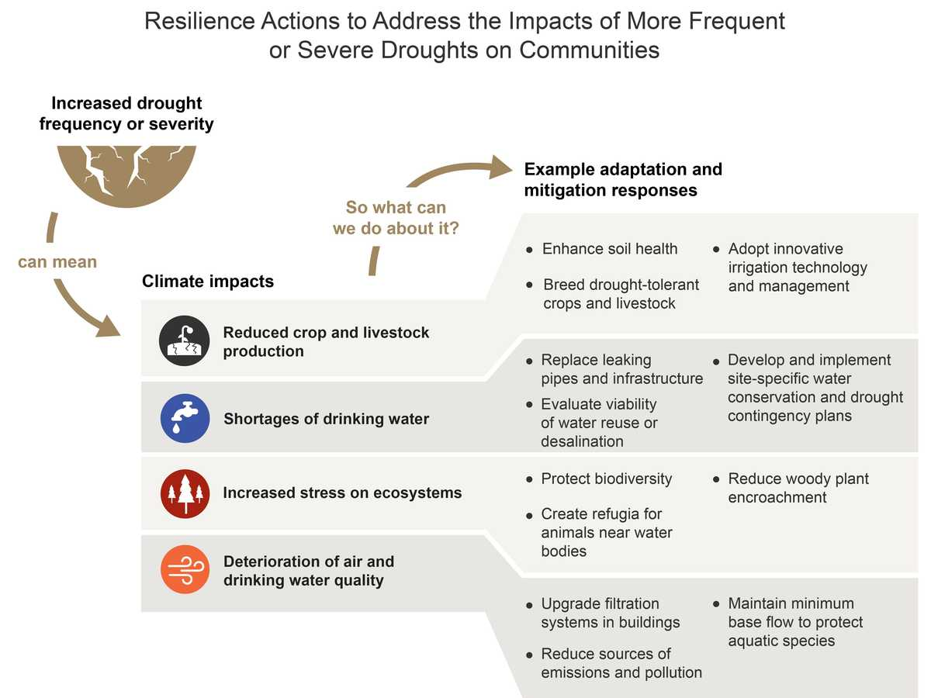
nca2023.globalchange.gov
nick.smith@ttu.edu

Slide 24

SGP KM2: How We Work: Climate Changes Are Creating Economic Challenges and Opportunities
nca2023.globalchange.gov
nick.smith@ttu.edu
…businesses and industries…are experiencing disruptions and losses in productivity and profits—but also new economic opportunities (high confidence). [Climate change is] expected to force widespread and costly changes in how we work (very likely, high confidence). Businesses and industries have opportunities to…develop products and services in climate mitigation technologies, adaptation strategies, and resilient design that will enhance the region’s economy (medium confidence).

Slide 25
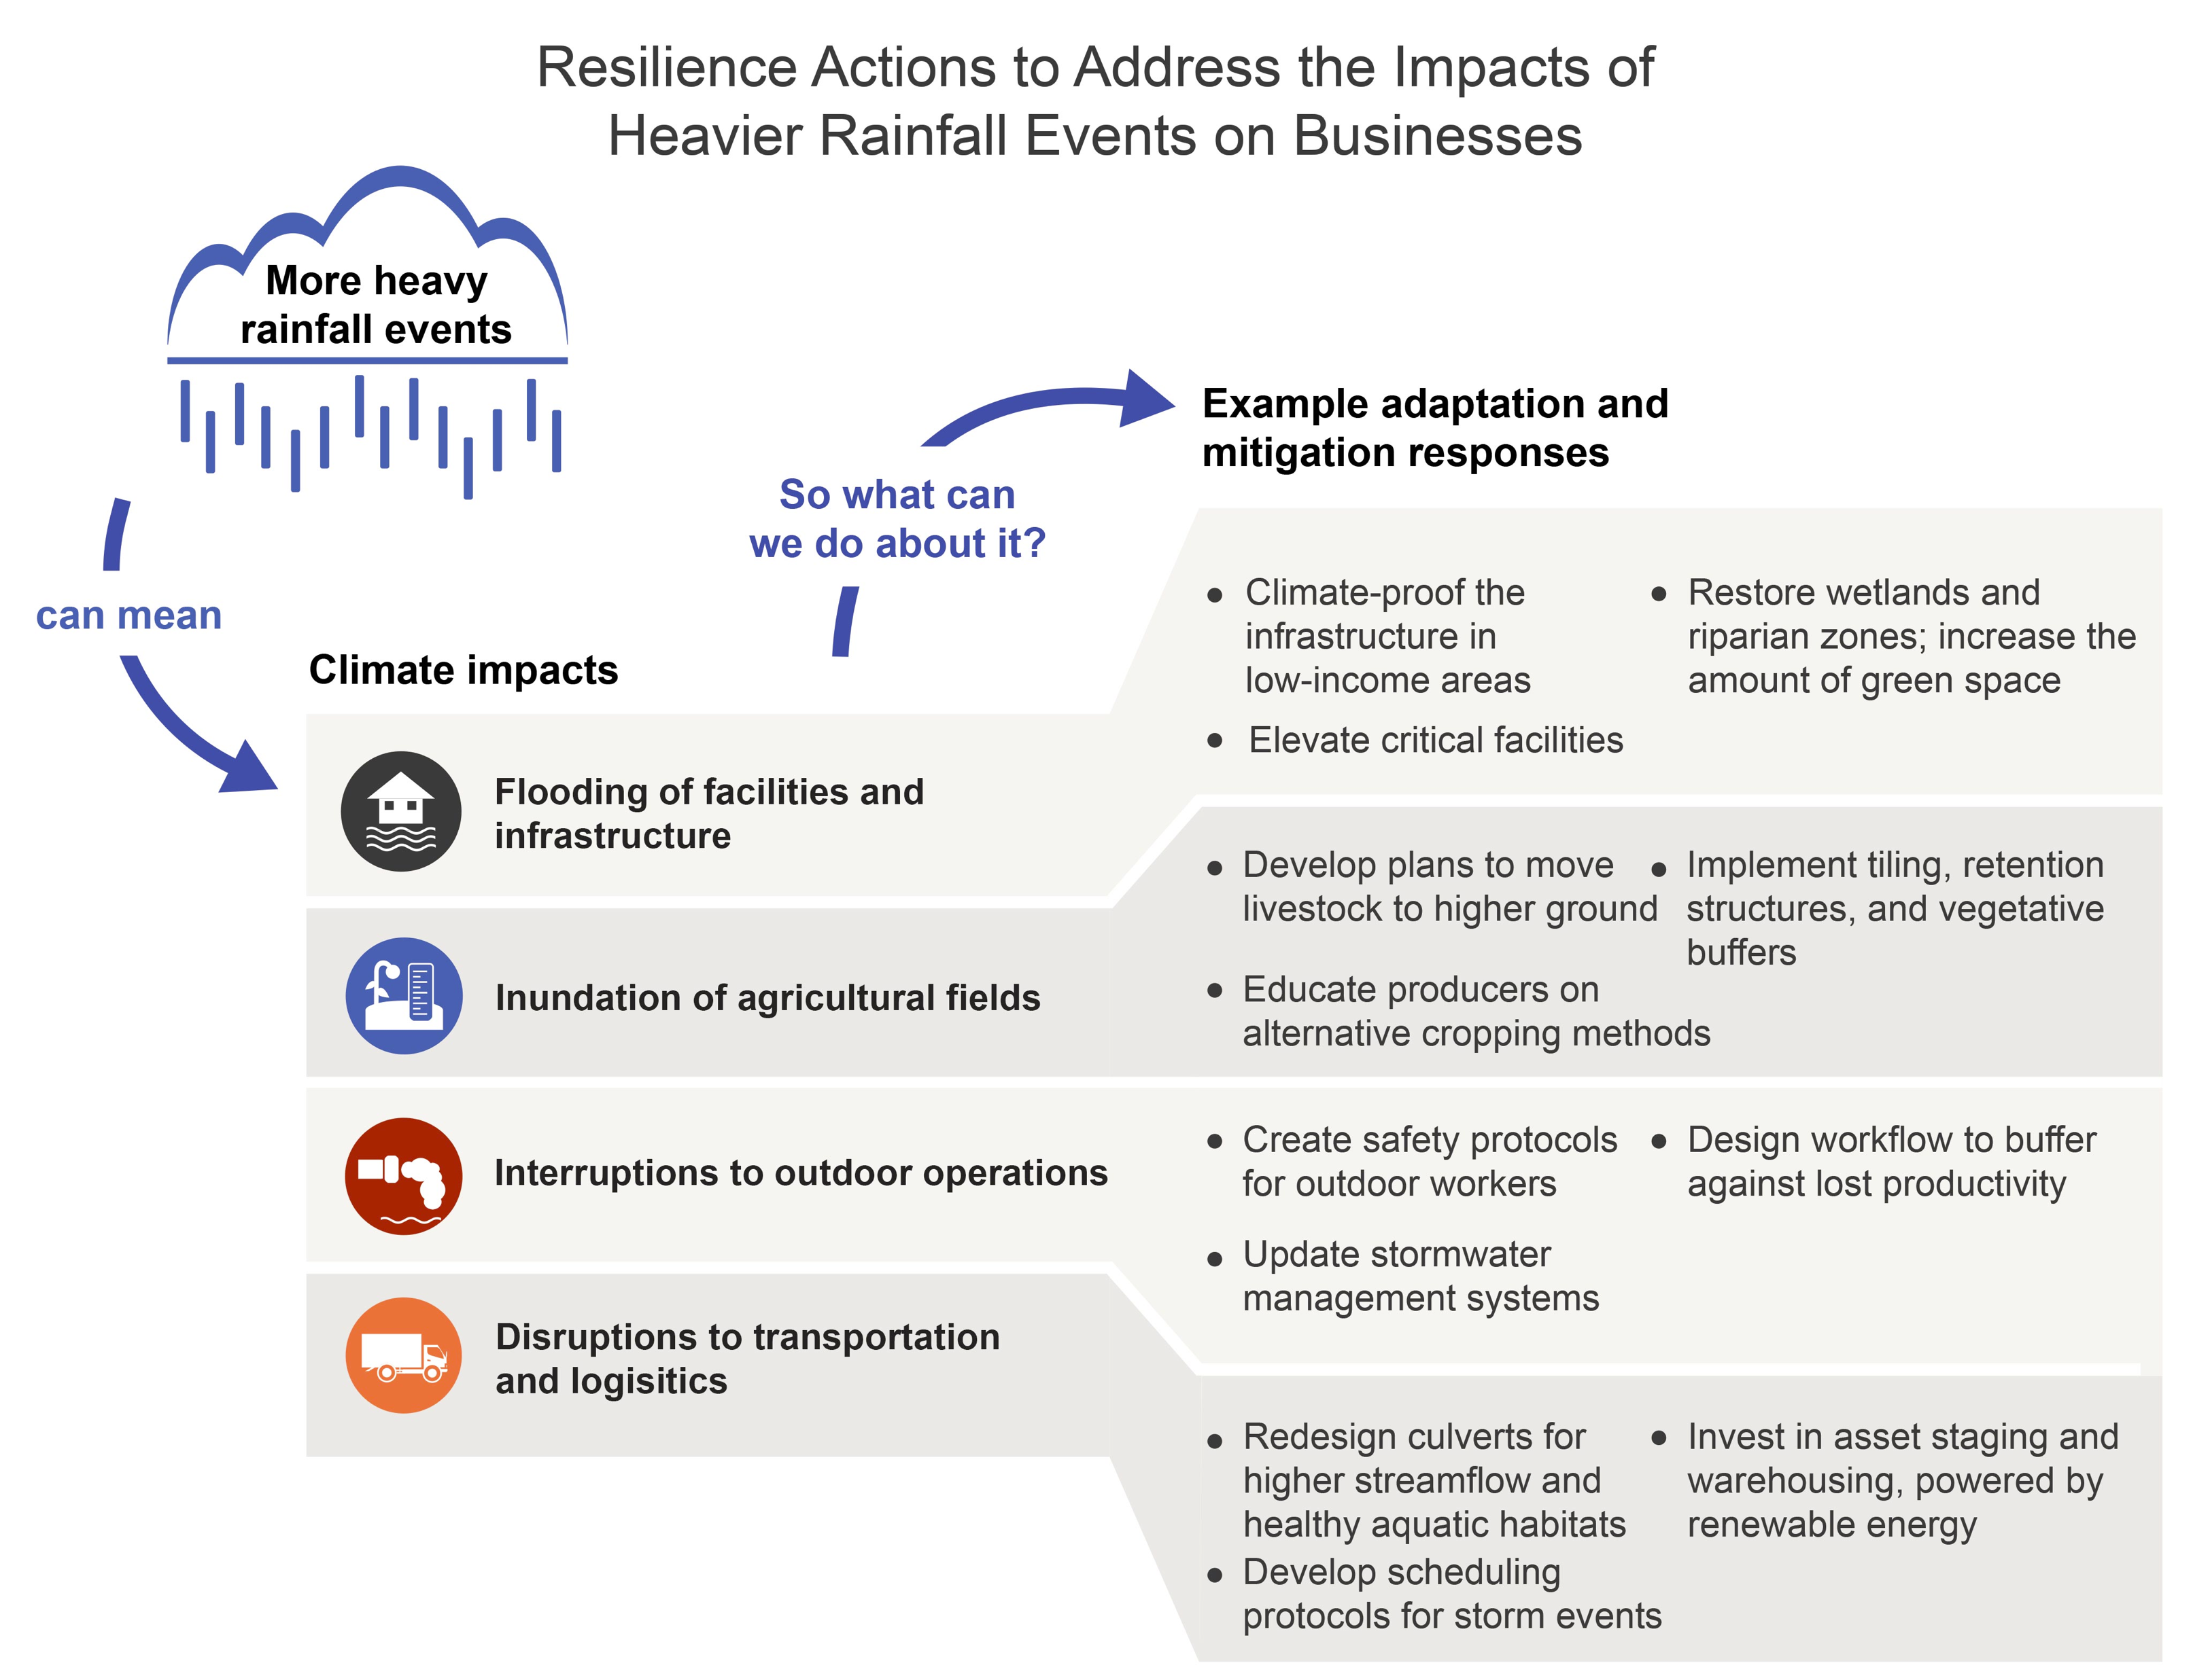
nca2023.globalchange.gov
nick.smith@ttu.edu

Slide 26
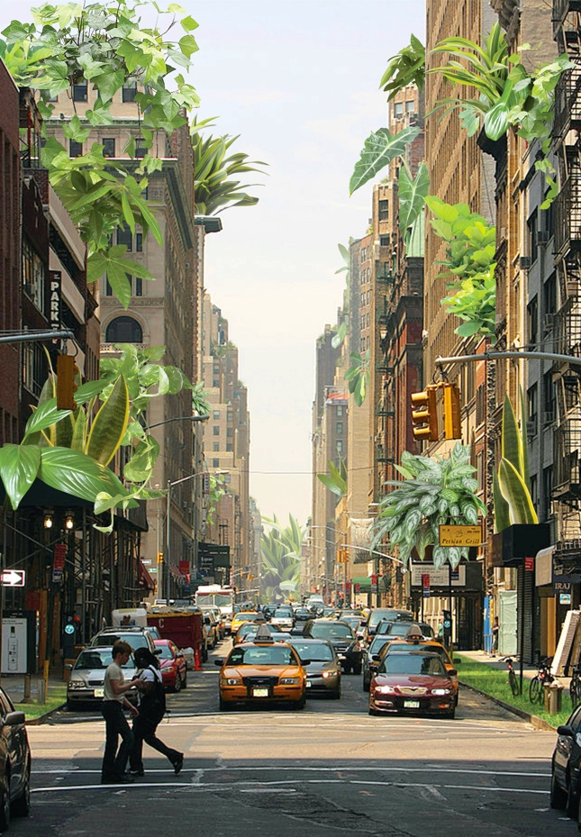
SGP KM3: How We Play: Climate Extremes Are Endangering Sports, Recreation, and Leisure
nca2023.globalchange.gov
nick.smith@ttu.edu
Extreme climate-related events are negatively influencing how we play and participate in outdoor sport, recreation, and physical activities…(very high confidence). Climate change is expected to increase heat-related illness and death, reduce outdoor physical activity, and decrease athletic performance (very likely, high confidence). Individuals, communities, and sports organizations can adapt to these hazards…(high confidence).

Slide 27
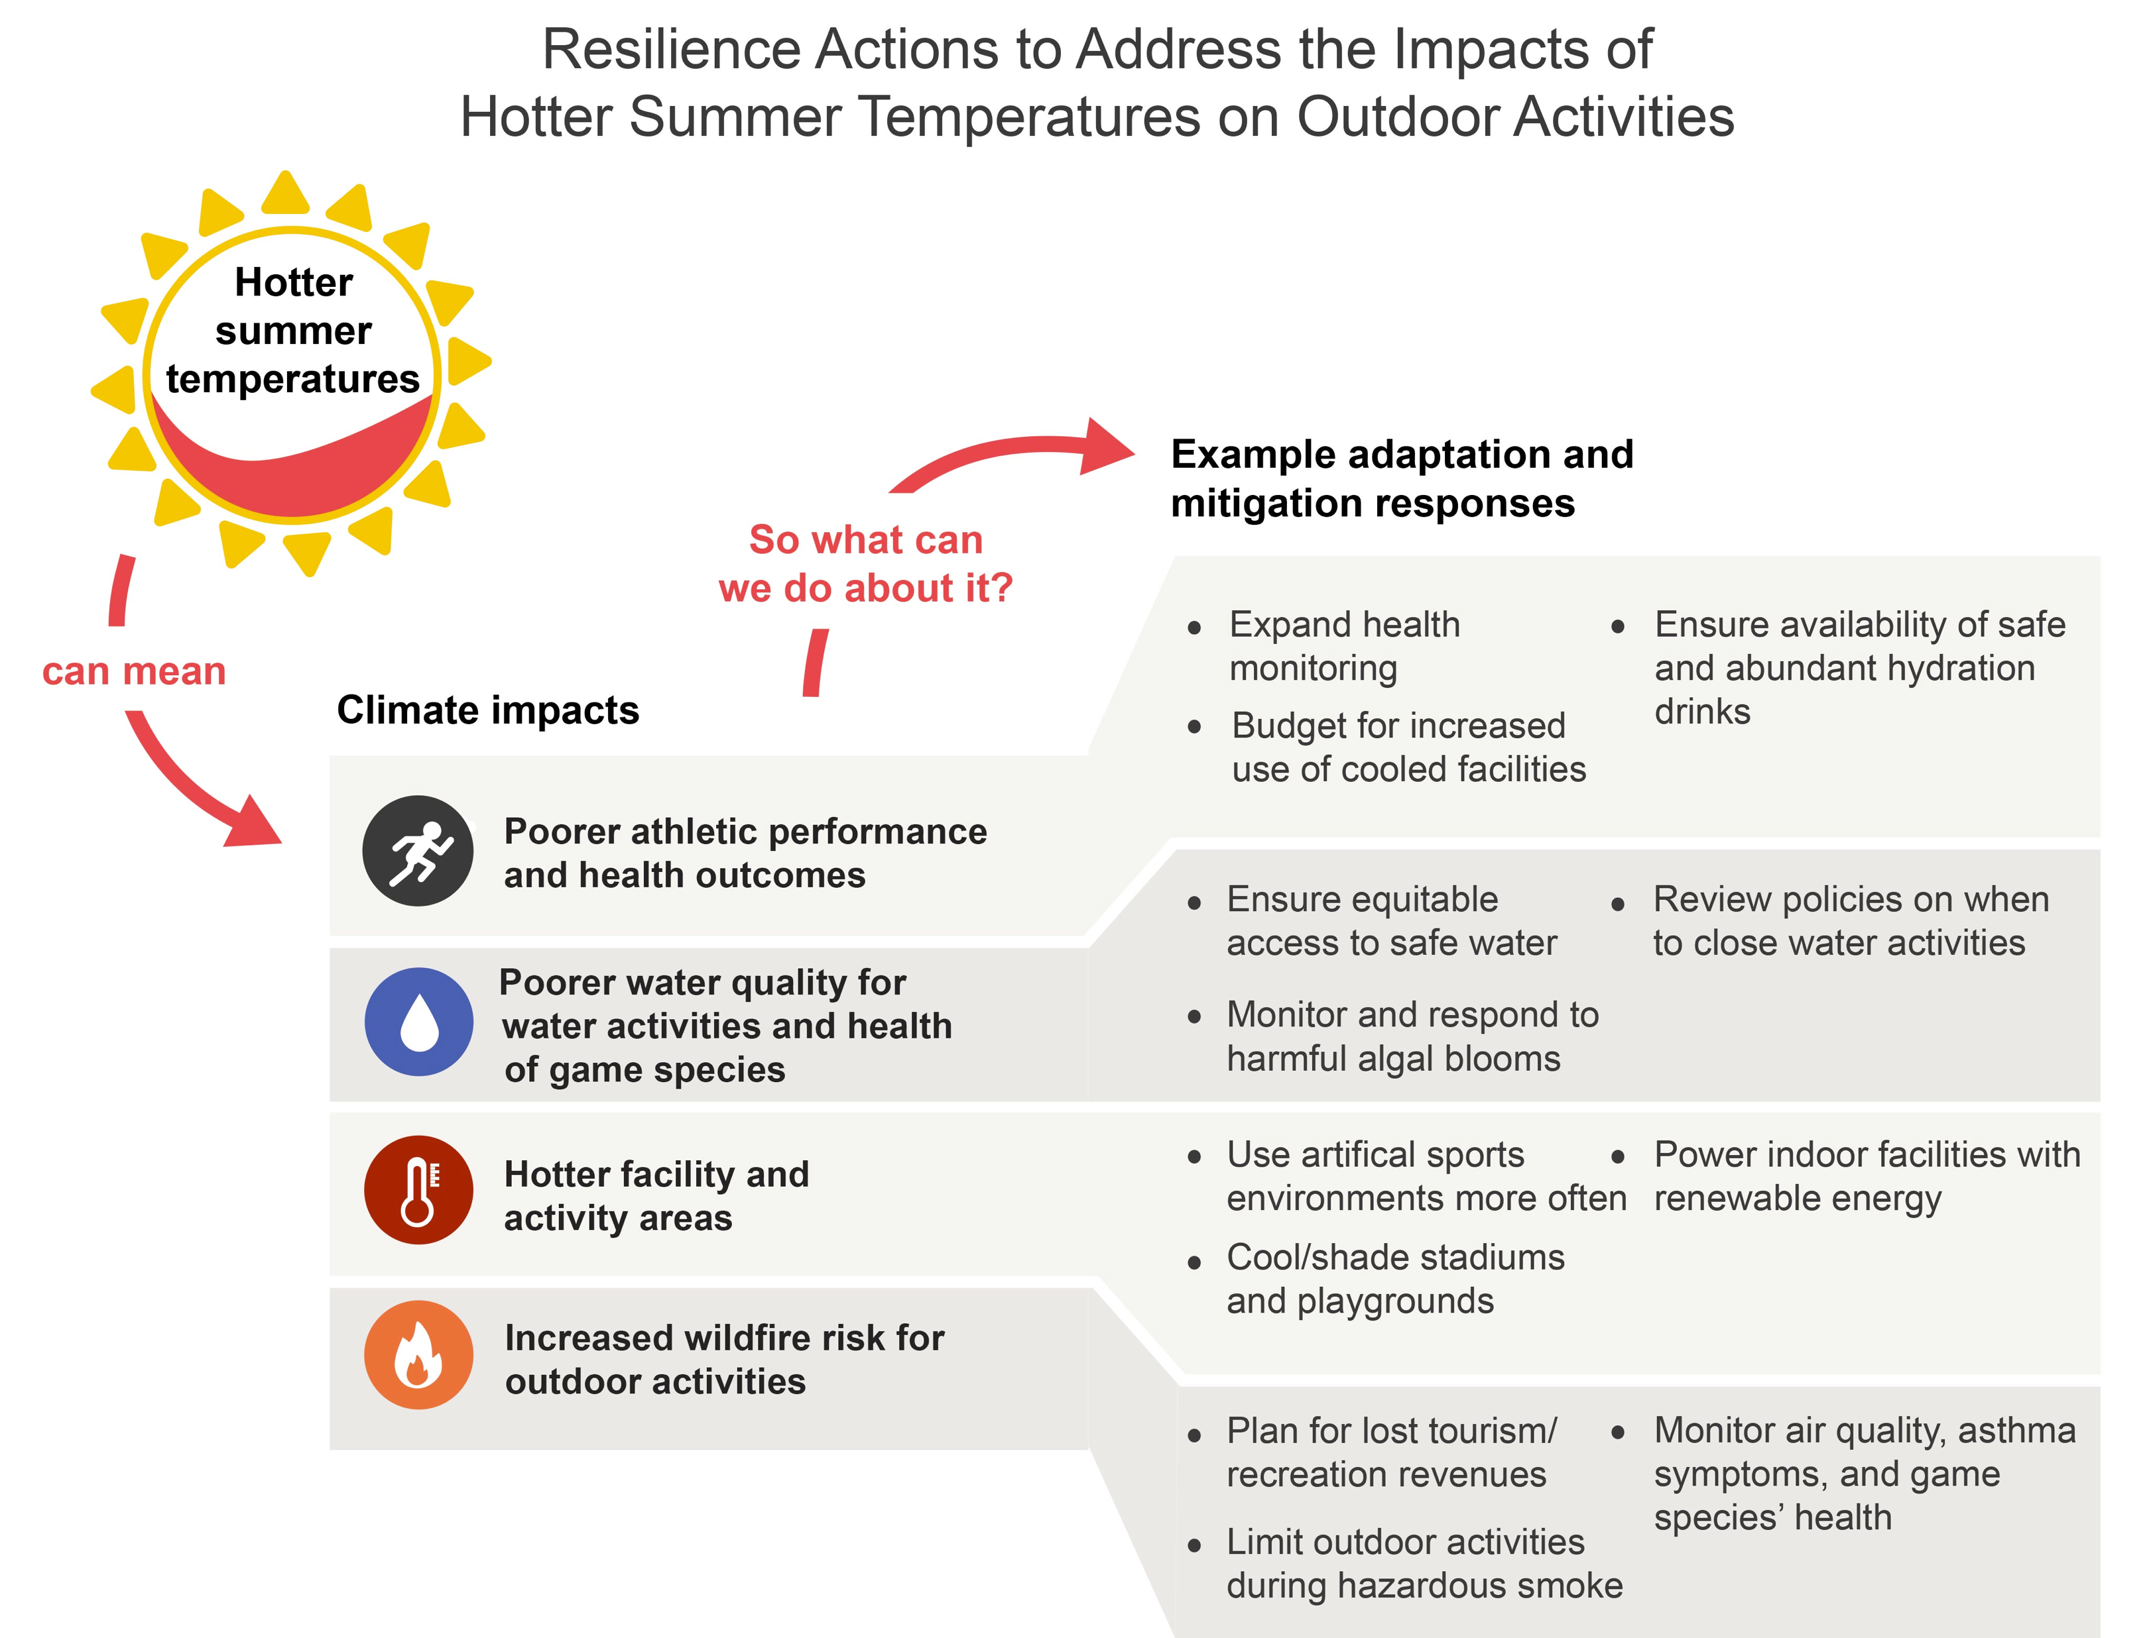
nca2023.globalchange.gov
nick.smith@ttu.edu

Slide 28
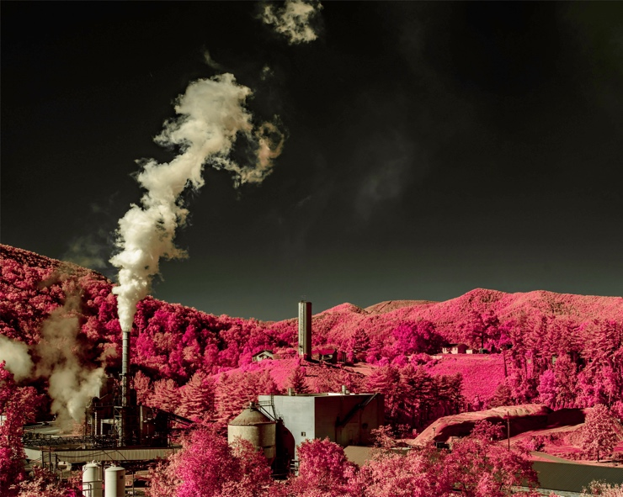
SGP KM4: How We Heal: Climate Change Is Exacerbating Existing Social and Environmental Disparities
nca2023.globalchange.gov
nick.smith@ttu.edu
Some…are suffering disproportionately from climate-related hazards because of long-standing marginalization, discrimination, and governmental policies (very high confidence)…climate change will compound existing social and environmental burdens on the people…with the fewest resources to prepare and adapt (very high confidence). Our institutions and governments can play a role in improving outcomes for these people and places by adopting…practices and policies that prioritize social equity and justice, aim to reduce community risks, build resilience, and repair past injustices (medium confidence).

Slide 29
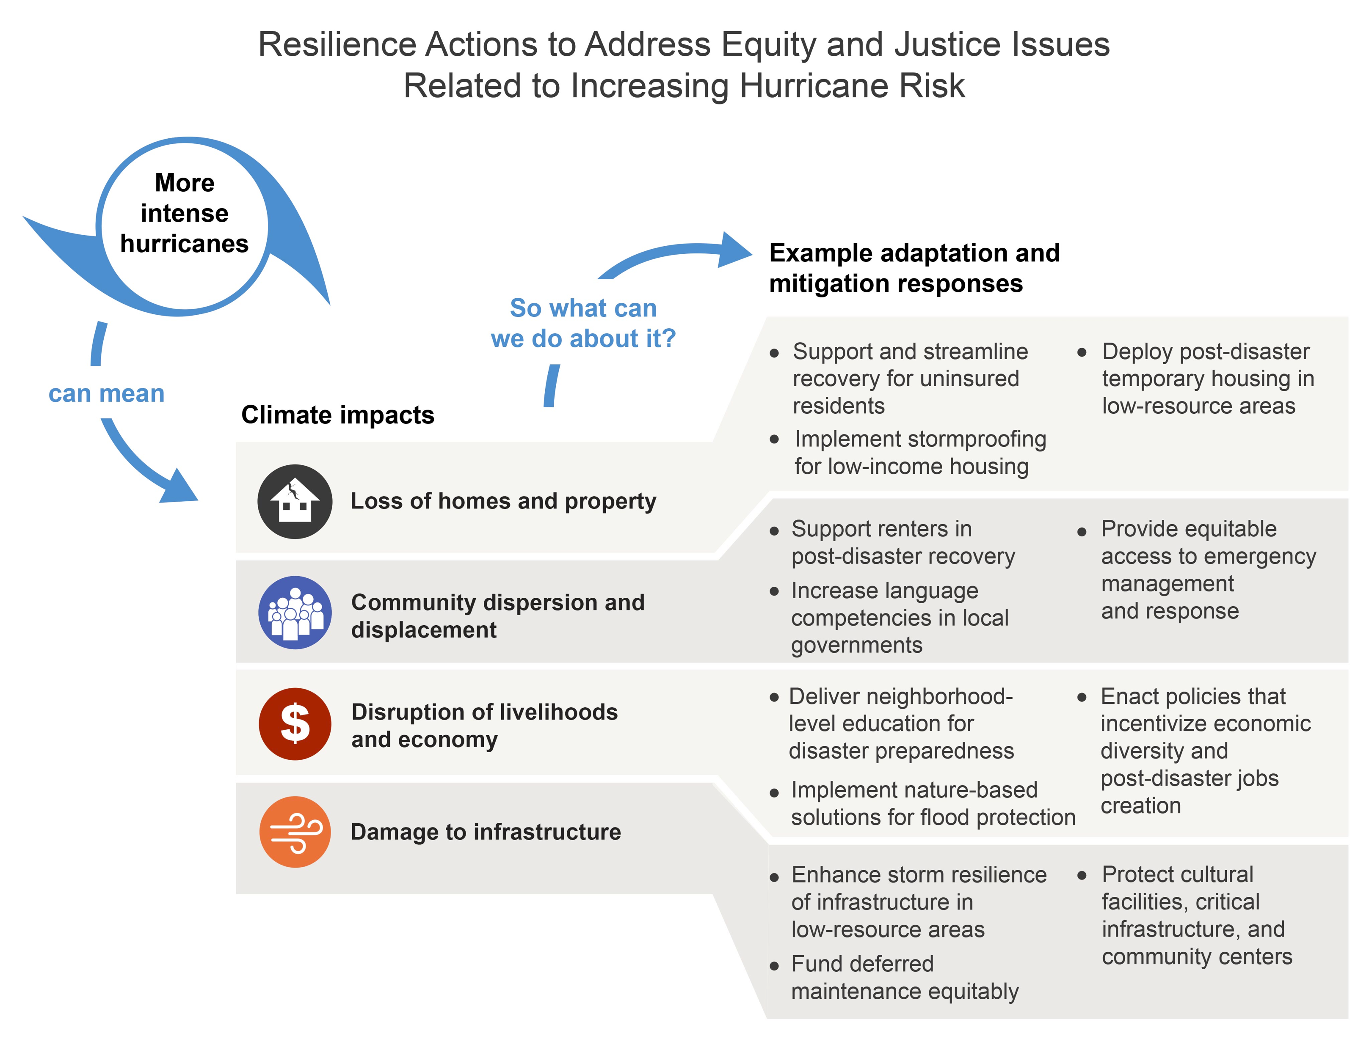
nca2023.globalchange.gov
nick.smith@ttu.edu

Slide 30
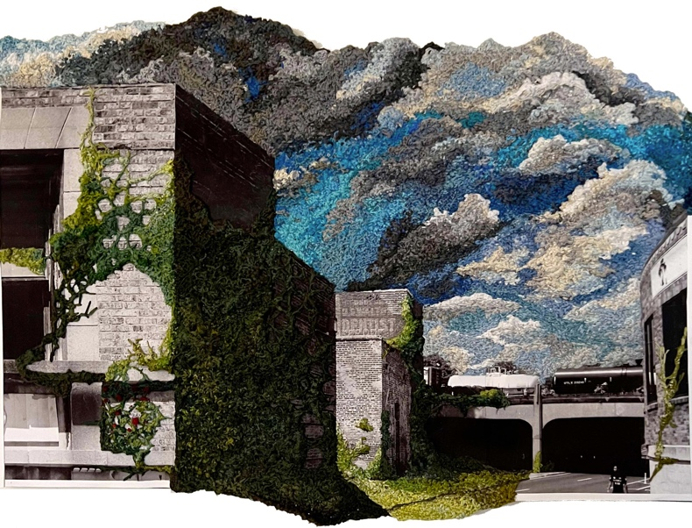
SGP KM 5: How We Serve: Climate Change Is Straining Public Infrastructure and Services
nca2023.globalchange.gov
nick.smith@ttu.edu
The institutions that serve our communities have been challenged to respond and adapt to more frequent and intense weather events (medium confidence)…climate change is expected to strain water supplies, transportation infrastructure, and emergency services…(high confidence). Actions that can enhance our community resilience include substantially reducing greenhouse gas emissions, installing or retrofitting climate-resilient infrastructure, educating students and the public on climate change, and cultivating the capacity of faith- and volunteer-based aid organizations to assist hazard planning, response, and recovery (medium confidence).

Slide 31
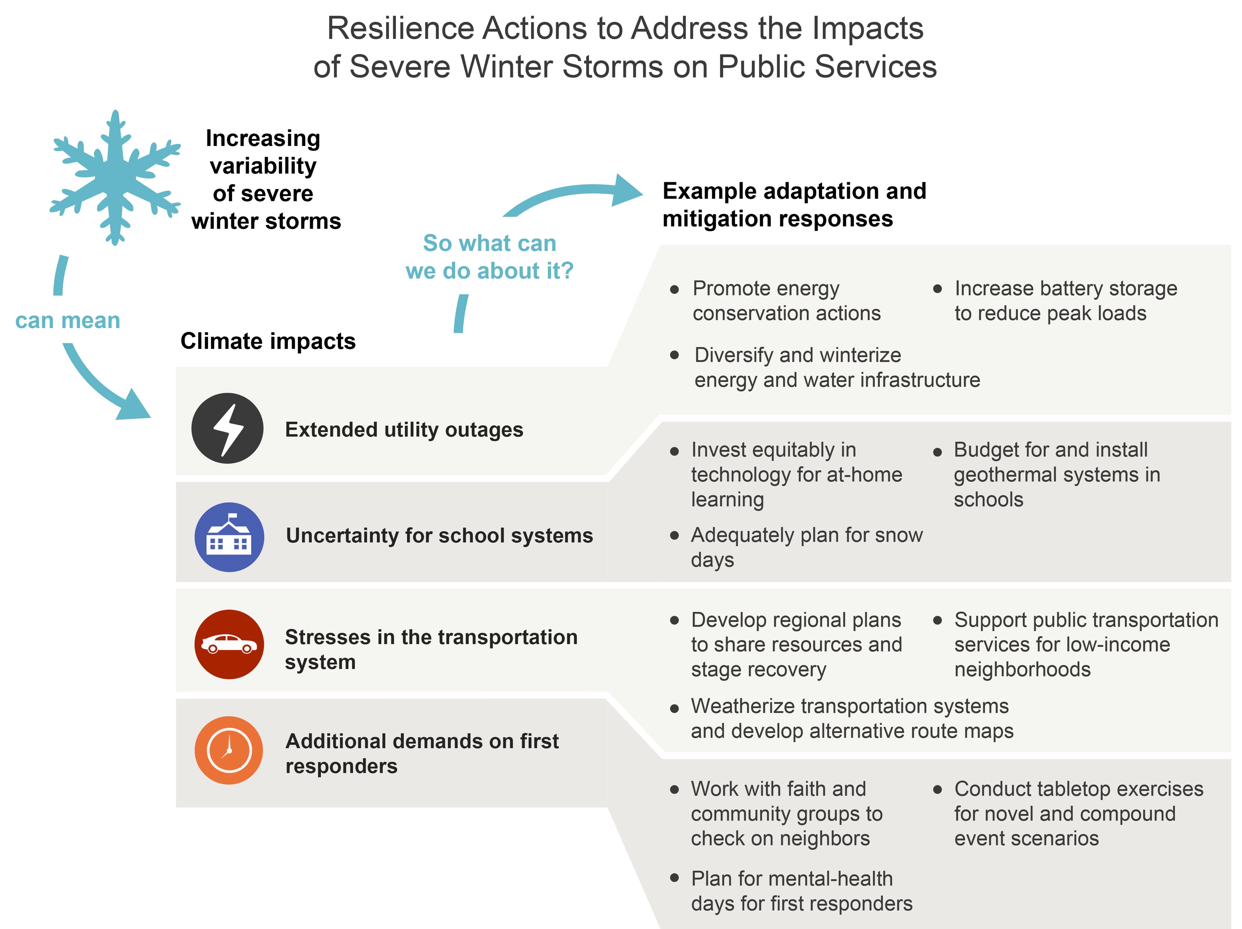
nca2023.globalchange.gov
nick.smith@ttu.edu

Slide 32
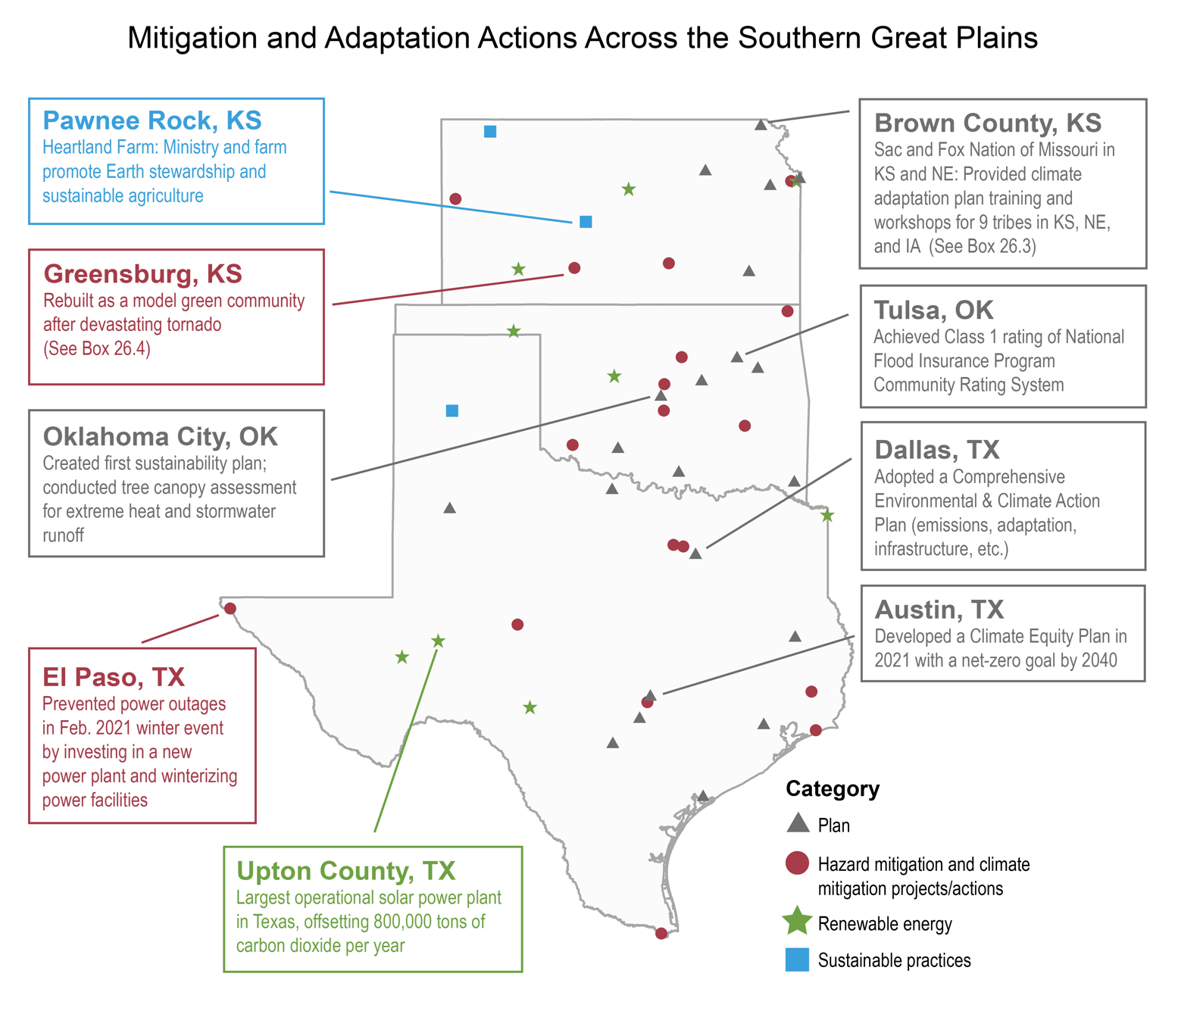
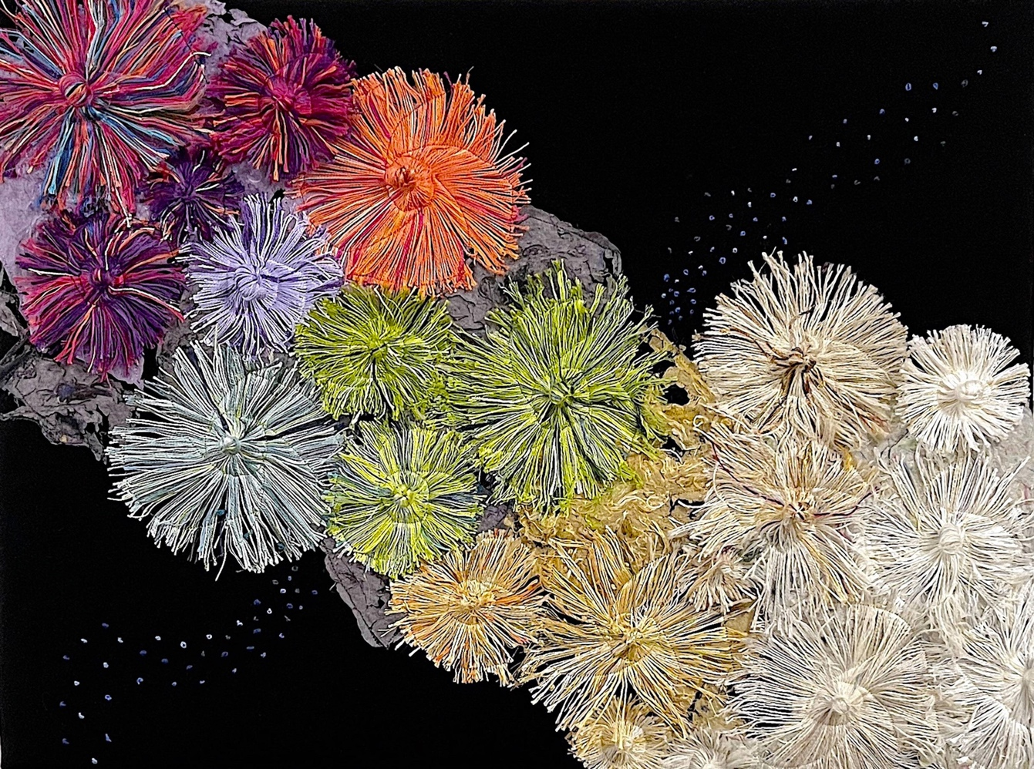
Where to find NCA5
nca2023.globalchange.gov
nick.smith@ttu.edu
The full report is online at nca2023.globalchange.gov
All chapter content, including figures, is freely available
Read and respond
Become involved in next NCA

Slide 33
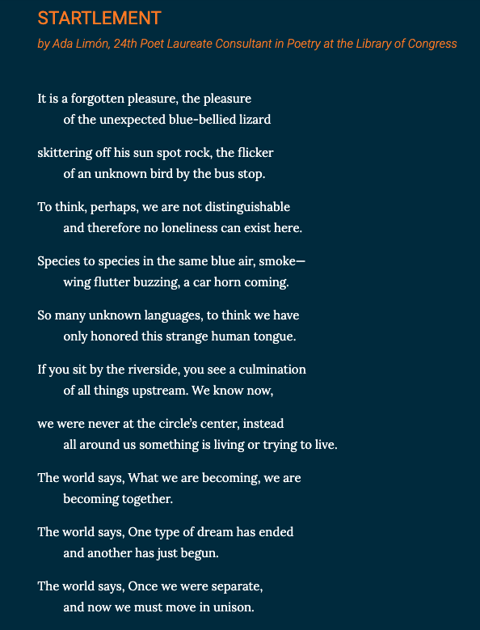
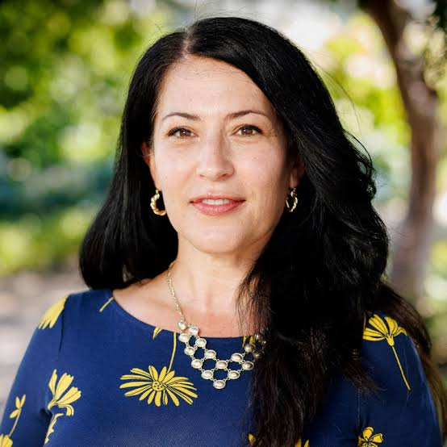
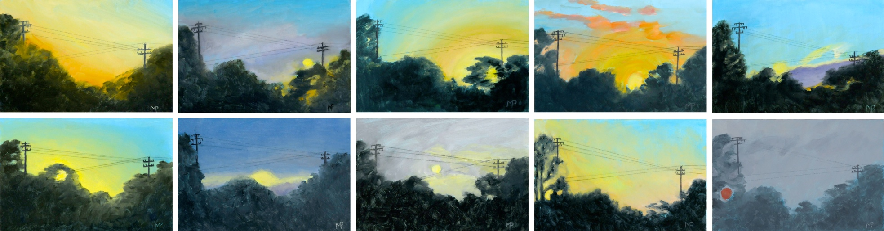
nca2023.globalchange.gov
nick.smith@ttu.edu
Ada Limón, 24th US Poet Laureate

Slide 34
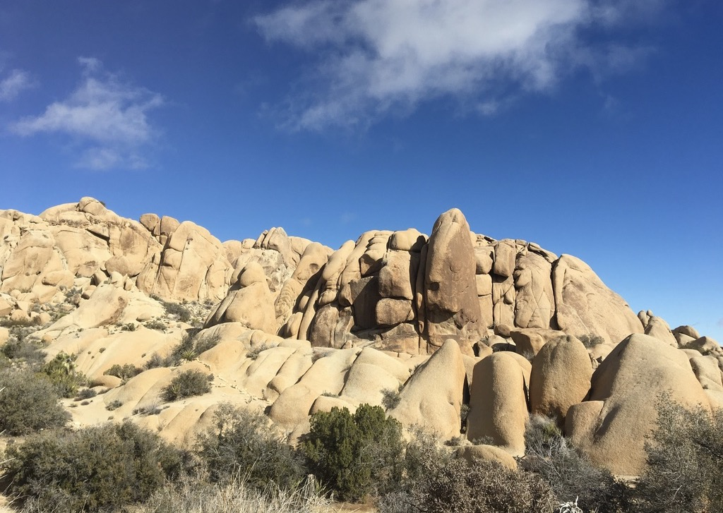
Presentation available at:
www.github.com/SmithEcophysLab/seminar/2023_sbtg
Nick Smith
nick.smith@ttu.edu
Thanks!

